Slide 1
INTRODUCTION TO INFORMATION SECURITY

Slide 2
OUTCOMES
Study the basics of information security
knowledge about security threats and attacks
Discuss the security issues network layer and transport layer
Apply security principles in the application layer

Slide 3
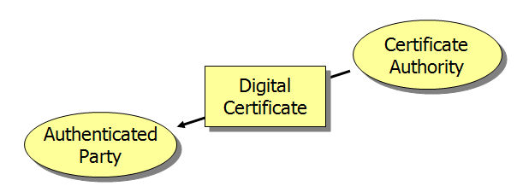
Digital Certificates
Created by a Certificate Authority
Certificate authority is the trusted third party

Slide 4
Certificate Authorities
Unfortunately, certificate authorities are not regulated
You must only use certificate authorities you trust
Company can be its own certificate authority for internal authentication among its hardware and software systems

Slide 5
Digital Certificates
Assert that a true party (named) has the public key contained in the digital certificate
Provides a name-public key pair
Therefore prevents public key deception
Fields and content are standardized by the ITU-T X.509 Standard

Slide 6
Digital Certificates
Certificate authorities may revoke digital certificates before the expiration date listed in the digital certificate
Revoked certificate ID numbers are placed in a certificate revocation list (CRL)
Verifier must check with the certificate authority to determine if a digital certificate is on the CRL
Without the CRL check, digital certificates do not support authentication

Slide 7
Common Vulnerabilities and Exposures (CVE)
Common Vulnerabilities and Exposures (CVE) is a catalog of known security threats. The catalog is sponsored by the United States Department of Homeland Security (DHS), and threats are divided into two categories: vulnerabilities and exposures.
According to the CVE website, a vulnerability is a mistake in software code that provides an attacker with direct access to a system or network. For example, the vulnerability may allow an attacker to pose as a super user or system administrator who has full access privileges. An exposure, on the other hand, is defined as a mistake in software code or configuration that provides an attacker with indirect access to a system or network. For example, an exposure may allow an attacker to secretly gather customer information that could be sold.

Slide 8
Firewall Deployment
SOFTWARE
Window’s firewall
Norton
McAfee
Bit Defender

Slide 9
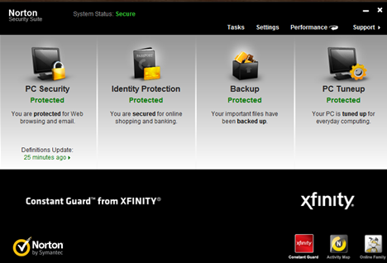
Firewall Deployment
Norton

Slide 10
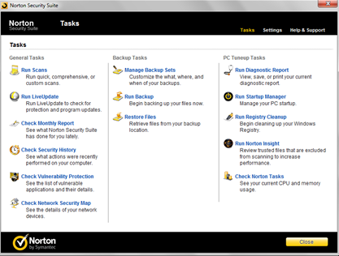
Firewall Deployment
Norton

Slide 11
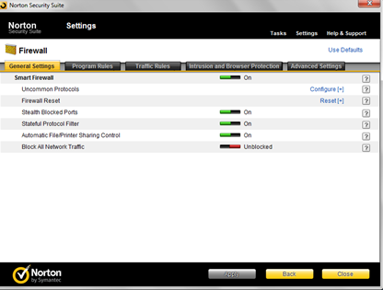
Firewall Deployment
Norton

Slide 12
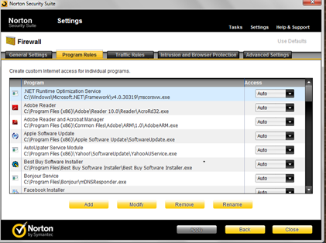
Firewall Deployment
Norton

Slide 13
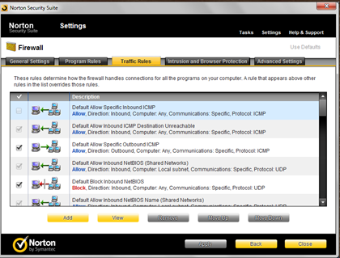
Firewall Deployment
Norton

Slide 14
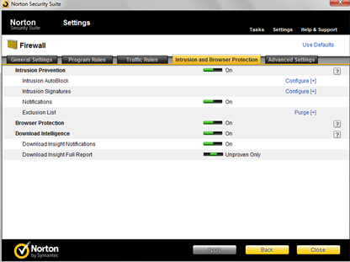
Firewall Deployment
Norton

Slide 15
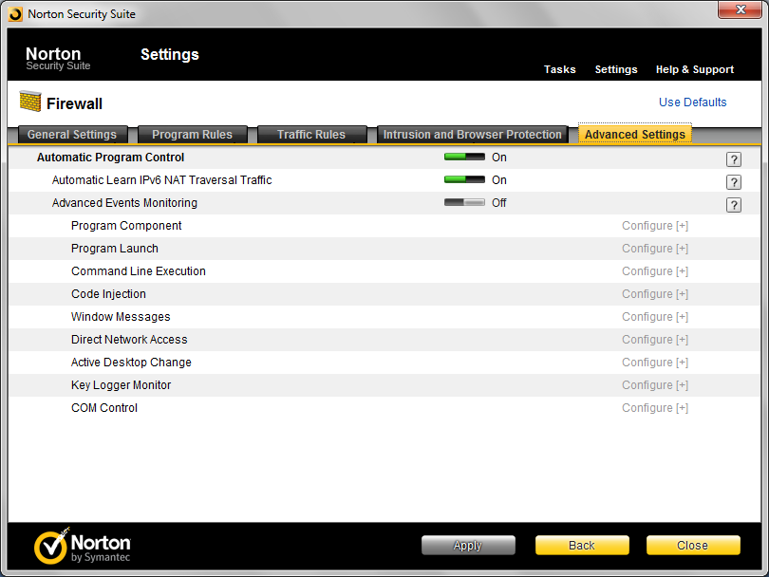
Firewall Deployment
Norton

Slide 16
Important Firewall Access Rules
The network administrator should be able to communicate directly with the firewall.
The firewall should not be able to communicate directly with any other device.
No other device should be able to communicate directly with the firewall.
Other network traffic should be routed directly to the appropriate servers.
All outbound communications should be allowed - unless corporate policy says otherwise.
The last rule should deny entry to any packet that does not match any other rule.

Slide 17
Website’s Identity
Website identity is important for user safety. While encryption is important, knowing who you are encrypting to is paramount when conducting online transactions. While many users can identify the green bar/lettering associated with an Extended Validation (EV) certificate, recent user interface (UI) changes by browsers make it more difficult to differentiate these certificates from low value, domain validated certificates. This makes it a challenge to figure out the true owner of the website.

Slide 18
Website’s Identity
For example, Chrome recently changed the certificate UI for Domain Validated (DV) certificates to show a green padlock. With an increase of DV certificates used by fraudsters for phishing
(see: http://toolbar.netcraft.com/stats/certificate_authorities), it is becoming more and more difficult for users to determine if a site is legitimate.

Slide 19
Website’s Identity
DV certificates don’t identify the entity behind the website. You just know you are connected to www.example.com. There is no ownership information vetted about example.com. Organizationally Validated (OV) and EV certificates provide ownership information allowing a user to know who the site belongs to. But unfortunately, browsers do not distinguish sites with these types of certificates.

Slide 20
References
Atul Kahate, “Cryptography and Network Security”, Second Edition, McGrawHill, 2010.
Information System Security, Nina Godbole, Wiley India, First Edition 2009.
Fundamentals of Information System Security, David Kim, Second Edition 2013.

